Slide 1
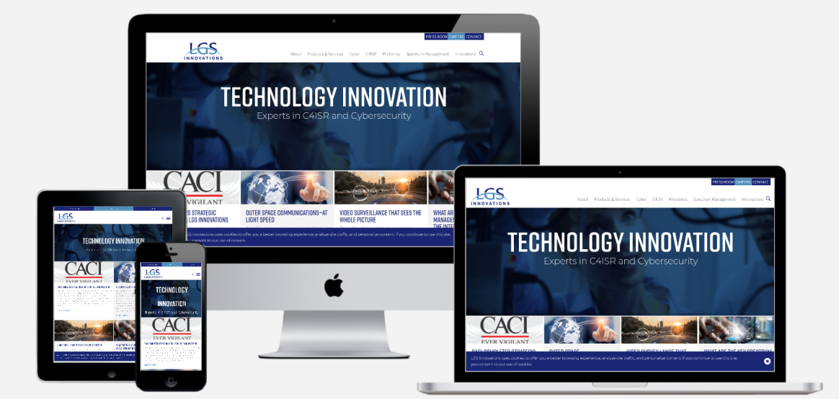
Web Development
Multi-responsive Webpage
By
R.Mithun Nitheesh Rogan

Slide 2
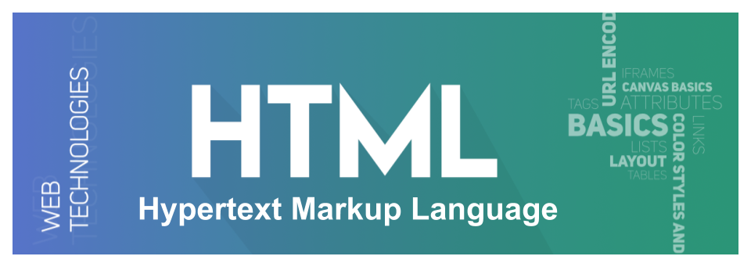
Table OF Contents
Introduction
2. Benefits
3. Importance
4. Working
5. Methods
6. Html ,CSS , JavaScript Tools
7. Project Implementation
8. Overview
9. Examples
10. Conclusion

Slide 3
Introduction
Web development is the work involved in developing a website for the Internet or an intranet. Web development can range from developing a simple single static page of plain text to complex web applications, electronic businesses, and social network services.
The concept of a responsive website appeared due to non-effective and ill-suited ways of handling screen sizes. Originally, pages were built to target a particular device. This approach implied creating a range of designs for each responsive tier resulting in different versions of the same page. However, with the mobile web becoming a reality and more and more devices with non-standard resolutions appeared, this approach has quickly become irrelevant since it could not handle this variety efficiently.

Slide 4
Benefits of Responsive Web Design
The main benefits of using a responsive website are
consistent visual experience;
better user experience;
no need for redirects;
lower bounce rates;
lower maintenance needs;
high web page loading speed;
no extra fees for creating and maintaining different versions;
easy analytics reporting.

Slide 5
Why is Responsive Web design Important?
The rise of responsive design has to do much with the rise of mobile devices, tablets, and smart devices like Kindle, game consoles, etc.
The modern-day user expects to be able to access any website with a vast range of devices. Your website should be ready to handle any scenario.
You cannot ignore these demands because numbers do not lie: according to recent studies, more than 80% of users surf through the internet using mobile devices in 2019;more than 60% of Google’s visits are done via a mobile device;
mobile devices accounted for more than 50% of website traffic worldwide.

Slide 6
How Does Responsive Web Design Work?
The idea behind responsive web design lies in building a flexible website whose content and design behave like water that fills the container, aka a device that customers use to visit the website.
All elements of the website undergo changes to feel comfortable inside the screen.
If it is necessary, they shrink to perfectly fit into smaller spaces or, on the contrary, stretch to occupy every inch of space.
Everything scales up or down automatically to match the device.
A responsive website’s key point is to understand that its primary task is to provide a comfortable user experience for anyone.
This requires ensuring good readability, proper visual experience, a certain level of accessibility, as well as maintaining consistent functionality from device to device.

Slide 7
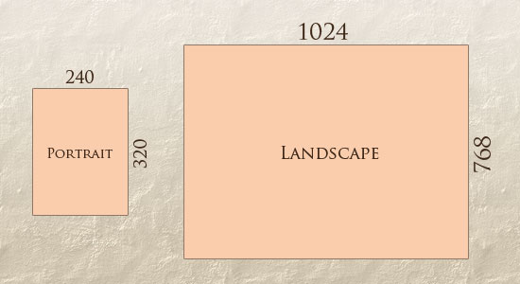
Flexible Layout
A flexible layout is the heart and soul of the design. As a rule, it is a flexible grid built with the relative units of measurement like percentages or em’s, rather than absolute units like pixels or points.
It is important to understand the ideology of a flexible grid that states that you need to add in a breakpoint when the content starts to look bad instead of covering all differently sized devices.

Slide 8
Flexible Images
Images have been an obstacle to implementing truly adaptable responsive pages since the dawn.
The deal is, use of a flexible grid in the project made us abandon our beloved pixels and replace them with relative units of measurement.
This means that all elements inside the grid should follow this lead. Images are no exception.
More so, by playing a crucial role in visual communication and user experience, they should first obey this principle.

Slide 9
Multiple Versions of the Same Image
The first method implies adding multiple versions of the image on the server. The simplest, the easiest, and the oldest but unfortunately not the most efficient way to handle this situation; nevertheless, it works.
This approach’s core principle lies in the fact that you need to upload multiple versions of the same image and dynamically serve the appropriately sized version depending on the user agent.
The main flaw of this method is, of course, overload. Modern websites are visually heavy.
There are hundreds of images on websites, and this number grows exponentially.
Although this approach served the community in the past pretty well, today, it can be used either in limited projects or in tandem with other modern techniques that help to optimize images and use as few of them as possible.

Slide 10
Use of CSS’s Max-width
The second method was suggested by Ethan Marcotte and was warmly accepted by the community in the early 2010s.
It makes the most out of CSS’s max-width. The idea behind that is you deliver images at the maximum size and let the browser resize the pictures deciding on their relative size based on the CSS guide.

Slide 11
Responsive Images
The third method implies the imitation of responsive images.
This technology has been with us for many years. Therefore, there are several ways for implementing it:
Depending on the viewport size or screen-density, you can choose the appropriate web-optimized picture from the collection and show it to the customer by using the srcset attribute in <img>.
Depending on the screen’s device CSS width, you can choose the same image with a different cut and focus on the image’s meaningful part by capitalizing on the <picture> attribute.
Use of image() function that allows cropping the picture differently, depending on the CSS viewport width size.

Slide 12
SVG
The fourth method implies using SVG. Although it does not work for photography, nevertheless the rest of the visuals, such as illustrations, icons, logotypes, etc., greatly benefit from this technology.
Each method has its own merits. Each one has its cons and difficulties in implementation.
Therefore, you might find that you benefit from one or another depending on the project you need to create.
What’s more, you may find yourself in situations when the best way to handle images is to turn off all of them and focus mainly on the content – believe it or not, that is also a viable way to handle this situation.

Slide 13
Media Queries
The third key ingredient of a responsive website is media queries.
Media queries allow building different layouts within one project by tweaking your whole design or parts to best suit the screen size.
With them, you can re-arrange and reorder existing elements like columns, rows, and containers using basic CSS. Based on the user agent’s features, such as the browser window’s size, orientation (landscape or portrait), screen resolution, etc., they provide different responsive tiers with a bunch of unique styles.
The great thing is that you can create multiple style sheets and define basic layout alterations to fit ranges of widths simply by combining different media queries. And they can be dropped right into a single style sheet.

Slide 14
Responsive Typography
Although modern websites are rich in visuals, still web design is all about shaping the written information. Content is a king. No one could argue against that.
Therefore, typography, as a prime tool to serve it, is increasingly important.
In the early 2010s, when the mobile web was still new, no one thought about making typography responsive since everyone was busy trying to master fluid grids and images. Today in the early 2020’s it is a crucial part of the larger puzzle.

Slide 15
Adjusting Screen Resolution
With more devices come varying screen resolutions, definitions and orientations.
New devices with new screen sizes are being developed every day, and each of these devices may be able to handle variations in size, functionality and even color.
Some are in landscape, others in portrait, still others even completely square.
As we know from the rising popularity of the iPhone, iPad and advanced smart phones, many new devices are able to switch from portrait to landscape at the user’s whim.

Slide 16
Flexible Images
One major problem that needs to be solved with responsive Web design is working with images. There are a number of techniques to resize images proportionately, and many are easily done.
Ex:img { max-width: 100%; }
As long as no other width-based image styles override this rule, every image will load in its original size, unless the viewing area becomes narrower than the image’s original width.
The maximum width of the image is set to 100% of the screen or browser width, so when that 100% becomes narrower, so does the image.

Slide 17
FILAMENT GROUP’S RESPONSIVE IMAGES
This technique, presented by the Filament Group, takes this issue into consideration and not only resizes images proportionately, but shrinks image resolution on smaller devices, so very large images don’t waste space unnecessarily on small screens.
Ex:<img src="smallRes.jpg" data-fullsrc="largeRes.jpg">
The JavaScript file inserts a base element that allows the page to separate responsive images from others and redirects them as necessary.
When the page loads, all files are rewritten to their original forms, and only the large or small images are loaded as necessary.
With other techniques, all higher-resolution images would have had to be downloaded, even if the larger versions would never be used. Particularly for websites with a lot of images, this technique can be a great saver of bandwidth and loading time.

Slide 18
Showing Or Hiding Content
It is possible to shrink things proportionally and rearrange elements as necessary to make everything fit (reasonably well) as a screen gets smaller.
It’s great that that’s possible, but making every piece of content from a large screen available on a smaller screen or mobile device isn’t always the best answer.
We have best practices for mobile environments: simpler navigation, more focused content, lists or rows instead of multiple columns.
Responsive Web design shouldn’t be just about how to create a flexible layout on a wide range of platforms and screen sizes.
should also be about the user being able to pick and choose content.
Fortunately, CSS has been allowing us to show and hide content with ease for years!
Ex: display: none;

Slide 19
TOUCHSCREENS VS. CURSORS
Touch screens are becoming increasingly popular. Assuming that smaller devices are more likely to be given touch screen functionality is easy, but don’t be so quick.
Right now touch screens are mainly on smaller devices, but many laptops and desktops on the market also have touch screen capability.
Touch screens obviously come with different design guidelines than purely cursor-based interaction, and the two have different capabilities as well.
Fortunately, making a design work for both doesn’t take a lot of effort.
Touch screens have no capability to display CSS hovers because there is no cursor; once the user touches the screen, they click.

Slide 20
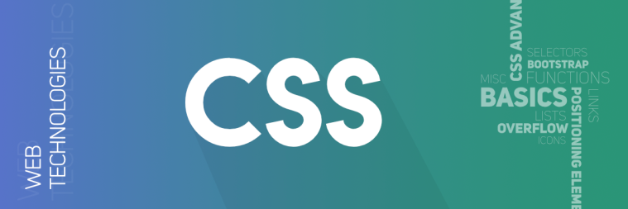
What are HTML, CSS, and JavaScript?
HTML is also known as Hypertext Markup Language which is used to create the core of web pages.
CSS also known as Cascading Styling sheets is used to make the webpage more attractive.
JavaScript is rather used to make the web pages more dynamic by providing fluidity through linking, buttons, etc.
These languages together form the basic part of web development. Web development is becoming a trending topic in the coming years with new versions of programming languages.
Creating a customized website will not be that hard and anybody who possesses the basic knowledge will surely be able to do it.

Slide 21
Overview
Creating a website is one of the prior tasks to endorse one’s business.
If you are about to open some business, then it is better to create a website and advertise on the internet.
Advertising and reaching people with the help of the website is quite common and effective.
Building a website is also very important when it comes to web page layout and their interconnections between them.
Although there are many readymade templates where you can get various designs, creating your own will help in connecting with the audience.
In this project, we will see how to create a multi-page responsive website that gives true results when interacted with.
To create the website we need to have some skills. These skills include HTML, CSS, etc.
These programming languages will help you create a good web page.
By creating web pages separately, we will need to connect every page through linking.
The linking tag which is used is in HTML i.e. <herf>

Slide 22
Project Implementation
First, we need to create a framework on how the webpage will look. The first page which is also known as the home page is quite important and the other subsequent pages are connected to its different links.
Then we will create the different web pages that will connect to the home page.
We can also create many other pages that will connect to that subsequent webpage.
To make the website more responsive, we can do the linking through different images, buttons, etc.
These can increase the approachability of the website.
The website should look attractive to get a click from the users, once you will learn all the necessary parts of web development in this course. You will be able to make good websites.
The languages HTML, CSS, and JavaScript are used to create, decorate, and make it more dynamic respectively. Using all these three basics parts we can create good web pages.

Slide 23
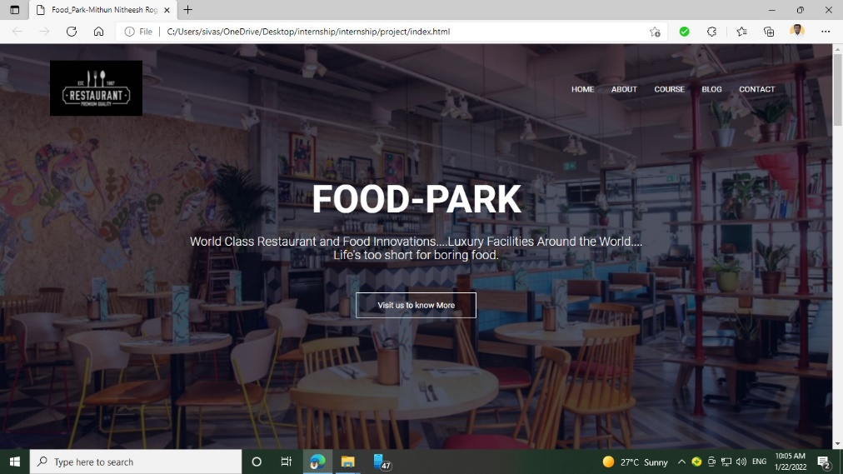
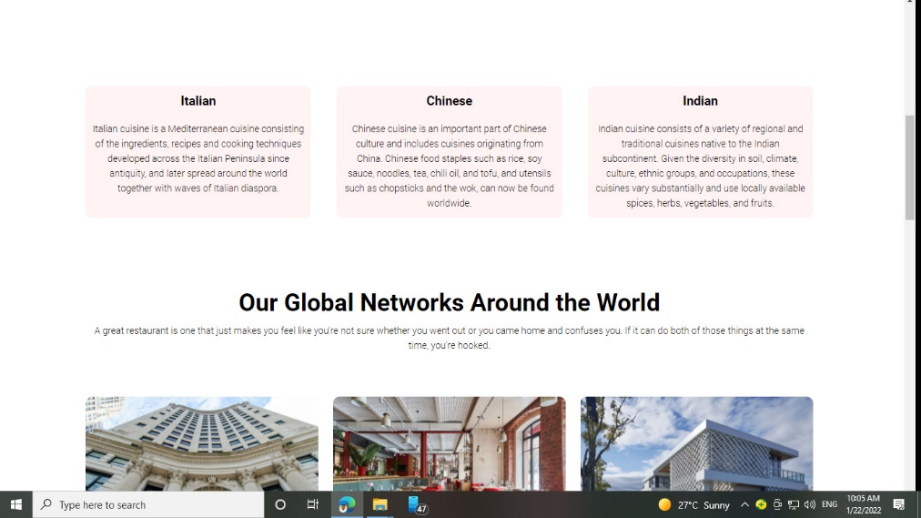
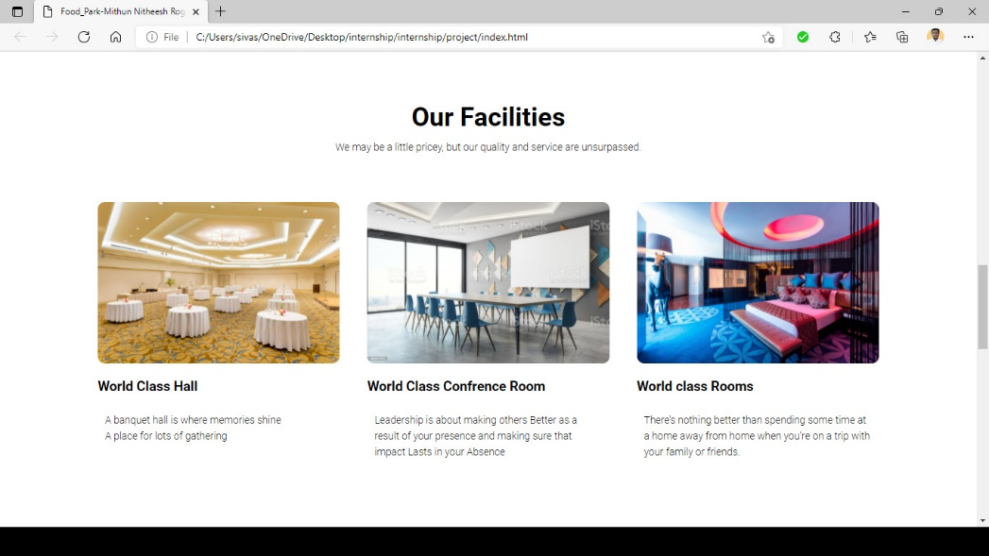
Screenshots

Slide 24
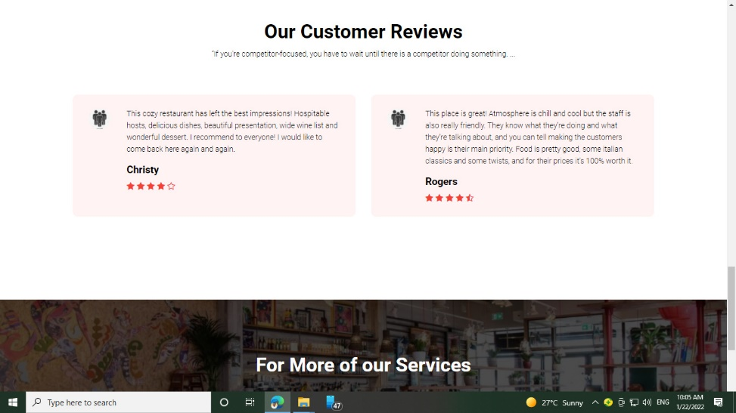
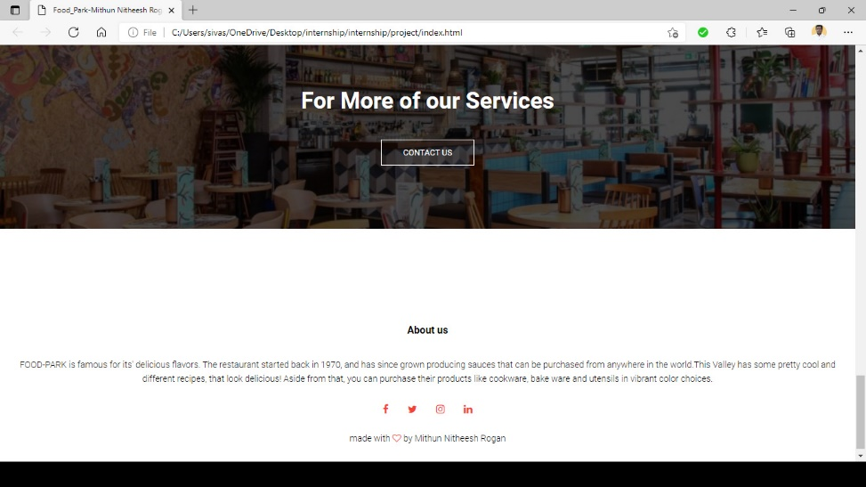
Screenshots

Slide 25
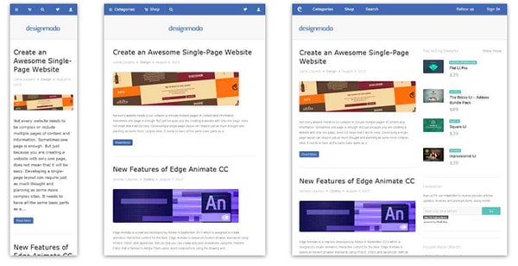
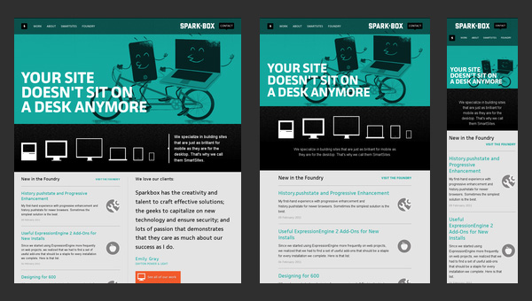
Responsive Web Design Examples
Responsive web design term is related to the concept of developing a website design in a manner that helps the layout to get changed according to the user’s computer screen resolution.

Slide 26
Conclusion
We are indeed entering a new age of Web design and development. Far too many options are available now, and there will be far too many in the future to continue adjusting and creating custom solutions for each screen size, device and advancement in technology.
We should rather start a new era today: creating websites that are future-ready right now.
Understanding how to make a design responsive to the user doesn’t require too much learning, and it can definitely be a lot less stressful and more productive than learning how to design and code properly for every single device available.
Responsive Web design and the techniques discussed above are not the final answer to the ever-changing mobile world.
Responsive Web design is a mere concept that when implemented correctly can improve the user experience, but not completely solve it for every user, device and platform.
We will need to constantly work with new devices, resolutions and technologies to continually improve the user experience as technology evolves in the coming years.

